Slide 1

IndiSoft’s Housing Advocacy Technology Platform
Date: 04/6/2020
Notes:
1.

Slide 2

Table of Contents
IndiSoft Basics ........................................................................ 3
Solution for the State of Nevada ............................................ 4
COVID-19 Projected Impact to Nevada ................................... 5
High-Tech, High-Touch Self-Service ......................................... 6
Key Features ........................................................................... 7
Rapid Response to Consumers ................................................ 8
HMN THOC & Home Retention Estimates Cost ........................ 9
Recommendation/Next Steps .................................................. 10-11
Appendix A, B, C – Key Clients & Past/Current Projects ............ 12-14
Appendix D, E, F, G – Statistical Data Sources ........................... 15-18
Appendix H, I, J – Professional Services Information................. 19-21
Estimated Cost Table ................................................................ 22

Slide 3
IndiSoft Basics
Headquartered in Columbia, MD and in business since 2005
Managed and maintained the Housing Advocacy platform for over 10 years
Developer and licensor of Patented Software as a Service solution (SaaS)
IS027001 Certified (Information Security Management System) and Microsoft Gold Partners
A 15-year history of providing technology to Fortune 500 companies, Government Sponsored Enterprises, Federal and State agencies and the Housing Advocacy sector
IndiSoft’s seasoned Executive Management Team played a critical role in working with Federal, State and Government Agencies as well as residential mortgage servicers and the Housing Advocacy sector to quickly create solutions for the Great Recession.
IndiSoft Named a 2020 Housing Wire Tech 100 Real Estate Winner:
https://www.housingwire.com/articles/2020-hw-tech100-real-estate-winner-indisoft/

Slide 4

Solution for the State of Nevada
Immediate Problem: Mortgage Servicer Capacity Challenge
Negative effect on Nevada (NV) homeowners seeking mortgage relief
Radical increase of calls to servicers due to COVID-19 crises
Excessive delays in providing homeowner access to Federal relief programs
After initial forbearance relief, there could be more permanent loss mitigation solutions, which could increase if home values decline.
Potential for mortgage servicer business failure/servicing transfer
Proactive protection for NV homeowners against financial predators
Immediate Solution: Implement Home Means Nevada (HMN) – The Homeowner Connect (THOC) self-service portal
A stand-alone, resource-rich portal offsets servicer under-capacity
A robust self-service portal eliminates the need for homeowners to call the servicer
On-demand chat and phone counseling provided by HUD certified non-profit Housing Counselors
Multi-Platform capabilities for distressed NV homeowners: Laptop, iPad, Mobile phone compatible
Viable alternative repository for servicer failures or messy MSR transfers
Aggressive Nevada campaign to preempt predatory practices by directing consumers to the safety of a free Nevada endorsed portal

Slide 5
COVID-19 Projected Impact to Nevada
Nevada Metrics – Observations
Week ending March 21, employment claims filed was 10 times the highest claims filed during the Great Recession
Highest 90+ Days Mortgage Delinquency Rate was double the National Average during the Great Recession
Highest ever unemployment rate was 47% higher than the National rate
The Hardest Hit Funds is still active today since its inception in 2010 due to the Great Recession (COVID-19 is expected to have a similar long-lasting impact)
Projections
Federal Reserve Bank of St. Louis President James Bullard predicts unemployment rate may hit 30% surpassing the 24.9% in 1933 during the Great Depression
As many as 30% of Americans with home loans – about 15 million households –- could stop paying if the U.S. economy remains closed through the summer or beyond, according to an estimate by Mark Zandi, chief economist for Moody’s Analytics.
Nevada is projected to have the biggest employment decline (-9.8%) in the US in 2020
Assume Nevada unemployment rate is projected to be 50% higher than the rate during the Great Recession when the US rate peaked at 9.3%, a linear projection based on the 2019 metrics in the table below (Unemployment rate, NODs and Proceed to Foreclosure) will project for the State of Nevada:
A 21% peak unemployment rate in 2020
A 16% peak 90+ Mortgage Delinquency rate in late 2020 to early 2021
Over 20,000 Notice of Defaults will be filed in late 2020 to 2021
Almost 15,000 certificates to Proceed to Foreclosure will be issued by HMN in late 2020 to 2021

Slide 6
High-Tech, High-Touch Self-Service
The Consumer-Direct Self-Service Portal includes unique, real-time chat and phone support from experienced HUD-certified Nonprofit Housing Counselors ensuring free, safe and competent assistance for distressed Nevada homeowners
HUD Counselor
Homeowner
Servicer
HMN THOC

Slide 7

Key Features
https://www.Thehomeownerconnect.org
“Where high tech meets high touch”
Updated to comply with COVID-19 Emergency Forbearance Borrower Attestation Form
Self-Service Options for Borrowers.
Mobile Accessible
On-Demand Phone/Chat Support from Nonprofit Counselors
Automated Tools for Supplying Key Data and Documents.
Option to white label
Mobile Friendly

Slide 8
Rapid Response to Consumers in Crisis
Distressed Homeowners submitting applications for Mortgage Payment Assistance
Applications Opened | 4,545
Complete Apps Submitted | 2,896
Submission Rate | 64%
Chat Sessions | 6,053
Phone-counseling Sessions | 790
Cycle-time for Submitting a Complete Application
74% completed and submitted within 7 days
The remaining 26% within 30 Days
80% of Live Chat Sessions end up submitting a complete application
1,188 unique customers utilized chat
These customers averaged 1.6 chat sessions per application
65% of the chats occurred prior to submission of the application
35% of the chats occurred after submission of the application
Avg. Speed to Answer: Chat 68 sec Calls 54 sec
Avg. Handle-time: Chat 12 min 48 sec Calls 4 min 12 min
Abandon Rate: Chat 0.05% Calls 3.4%
Borrower Survey
Customer Chat: 94.9% Satisfied 5.1% Unsatisfied (due to process challenges)

Slide 9
HMN THOC & Home Retention Platforms Estimated Costs
TOTAL ANNUAL COST YEAR 1 - $480,050
Monthly Cost & Fees for Year 1 - $358,800
One Time Setup and Implementation Cost & Fees for Year 1 - $121,250
Annual Cost Breakdown:
The Nevada “The Homeowner Connect” Platform (NTHOC) and Home Retention License fees
$180,000 Per year plus $23,600 (one-time setup fee)
Technology Costs – Hosting Infrastructure (Pass Through) and Live Chat Tech (Pass Through) Fees
$63,600 per year * plus $6,550 (one-time setup fee)
HUD Certified Housing Counseling (All Pass Through) – Base, Phone Interview and Chat Fees
$ 70,800 per year plus $ 4,000 (one-time setup fee)
Other Costs – Support, Integration SOW, Program Mgmt, Texts, Training and Contingency Costs
$ 44,400 per year plus $ 87,100 (one-time setup fee)
NOTE: Total Annual costs exclude any Miscellaneous Services Costs/Fees such as new SOW requests, per case submitted to servicer charges (TBD projected revenue share), E-Signatures and any variable costs that are subject to case volumes, activities and Service Level Agreements (SLA)

Slide 10
Recommendation/Next Steps
Time-to-Market is Critical
The COVID-19 emergency may cause foreclosures and sales in the residential market based on decreasing values and job loss
Draft and execute addendum to the current Contract ASAP
Go Live with the White Label “Out-of-the-Box” version of HMN-THOC immediately after the addendum is fully executed
Make it Mandatory for all mortgage servicers that they must accept all Home Retention Cases and COVID-19 Forbearance requests from Nevadans who chose the Nevada consumer-direct Portal
(See precedent set by The State of Nevada Foreclosure Mediation Program below)
Rule 1. The State of Nevada Foreclosure Mediation Program
Availability of program. Subject to limited exceptions set forth in Rule 11 hereafter, the Foreclosure Mediation Program is mandatory when the grantor or person who holds title of record of an owner-occupied residence timely files the Petition for Mediation Assistance.

Slide 11
Recommendation/Next Steps
Time-to-Market is Critical (Continued)
Link “HMN - THOC” to COVID-19: Helpful Resources for Nevadans on https://www.leg.state.nv.us/
Link “HMN - THOC” to http://www.homemnv.org/
Include the recommended post-implementation program-management plan outlined in Appendices H,I & J.

Slide 12








Appendix A – Key Clients
- 12 -

Slide 13
Appendix B - Key Solutions to the Prior Mortgage Crises
Throughout our history, we have been the go-to technology platform for most national programs. Key past and current projects include:
Enrolled Top Servicers (2008-2011) Enlisted 19 of the top 20 servicers, servicing more than 80% of the residential mortgages in the United States.
Launched Consumer Direct Portal (2011) Allowed homeowners to submit workout packages directly to a servicer and get connected with a counselor.
Emergency Homeowner Loan Program (2011) Selected by HUD and NeighborWorks as the required technology platform for the EHLP program.
National Mortgage Settlement (2012) Named in Section IV.E.3 as the model required web portal to be emulated, if not used, for consumers & counselors.
Started Non-Retention Alternatives (2012) Added non-retention options (short sales and deeds-in-lieu) to the platform.
Bank of America (2012-13) Completed an integration with their loan servicing system and channel for all third parties to submit packages.
Treasury Directive 13-08 (2013) Developed a construct for compliance with Post-Modification counseling requirements.
Home Affordable Program (2013) Selected by Treasury Department and NeighborWorks as the required technology platform for implementation of Treasury Directive 13-01, requiring HLP use in order for housing counselors to get paid for loss mitigation counseling and document collection.
Mortgage Servicing Rights Transfer (2013) Implemented a utility to allow the transfer of workouts-in-progress for MSR cases between servicers.
Wells Fargo (2013-15) Completed an enterprise integration to become the preferred channel for all consumers’ authorized parties and housing counseling agencies fee-for-service work with borrowers. Added new support for foreclosure mediation and bankruptcy cases.
Foreclosure Mediation (2014) Launched a multi-stakeholder case to solve document and communications problems associated with mediation
Fannie Mae (2014) Created an investor portal for Fannie Mae’s Advocacy Group to replace Home Counselor Online and better manage Mortgage Help Network counseling agencies and case submissions.

Slide 14
Appendix C - Key Solutions to the Prior Mortgage Crises
Throughout our history, we have been the go-to technology platform for most national programs. Key past and current projects include:
Servicer Advisory Council (2017) Reconstituted this industry group to gather ideas and seek advice for collaborative development on emerging needs.
Fair Housing Platform (2017) Implemented an intake and case management system for the collection, processing and resolution of fair housing complaints. Submitted collaborative grant for funding.
Disaster Assistance Case Type (2017) Built a quick and easy way for borrowers to connect with servicers to create a permanent record, share updated contact information and explain how the property and/ or ability to make mortgage payments has been impacted.
Government-Sponsored Mediation (2017) Selected by the Florida Bankruptcy Courts and Foreclosure Diversion Court in Philadelphia. Standardize processes and improve collaboration of the parties seeking foreclosure alternatives.
Homeowner Connect 2.0 (2017) Relaunched a new, more relevant and homeowner-driven experience. Provides online tools and on-demand access to trusted experts for additional support and help.
OCC Consent Order (2017) THOC was an integral part of a top-five commercial bank’s successful remediation plan to satisfy an OCC Consent order for poor consumer loss mitigation engagement and outreach.
MBA Loan Sub-Committee on MSR Transfers (2014) Selected for test as utility for documenting/ensuring a seamless bulk transfer of MSR cases.
Bankruptcy Mediation (2014) Developed another multi-stakeholder case to support mediation for homeowners in bankruptcy.
Freddie Mac Dashboard (2016) Implemented a dashboard to aggregate the data of Borrower Help Centers, offering insights on activity and performance of the nonprofit housing counselors.
Borrower Outreach Program (2016) Delivered a customized outreach program to Ditech borrowers to meet the requirements of FHFA’s principal reduction program.
Post-HAMP Case Type (2016) Adapted the platform to support home retention cases after the expiration of HAMP.
PHFA - State HFA Platform (2016-17) Implemented a comprehensive platform to manage full-cycle lending and servicing that leverages its 77 nonprofit housing counseling agencies. Includes a CMS for counselors, servicing portal, affiliate management tools, mediation portal and HLPGuru to share information and interact with stakeholders. Also automates the manual HEMAP processes.

Slide 15
Appendix D – HMN Foreclosure Mediation Program Stats for Fiscal 2019
Fiscal 2019 – 4,001 Notice of Defaults filed
Clark County – 3,050
Washoe County – 414
Petitions to participate in the Foreclosure Mediation Program (FMP) – 298
HMN issued 3,840 Certificates to proceed with Foreclosure
3,603 Certificates issued because no petition was filed
233 Certificates issued as directed by the Court after completion of mediation
4 waivers
Petitions filed to participate in the FMP
472 Mediations were completed (includes some Petitions from Fiscal Year 2018)
233 - Certificates issued
239 - No Certificates issued

Slide 16
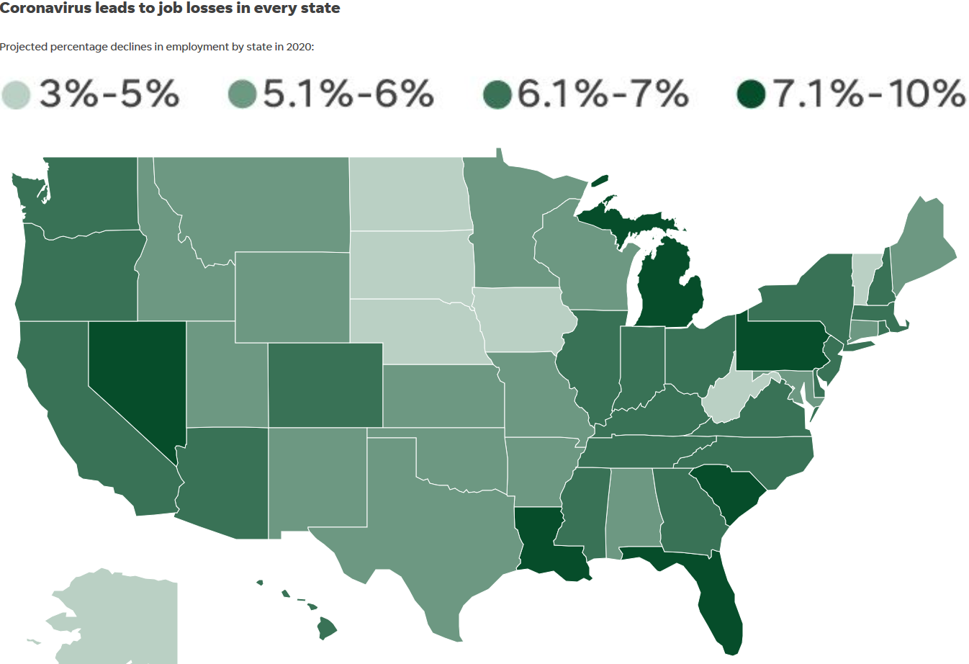
Appendix E - Projected % Declines in Employment by State in 2020
-9.8% Highest in the US

Slide 17
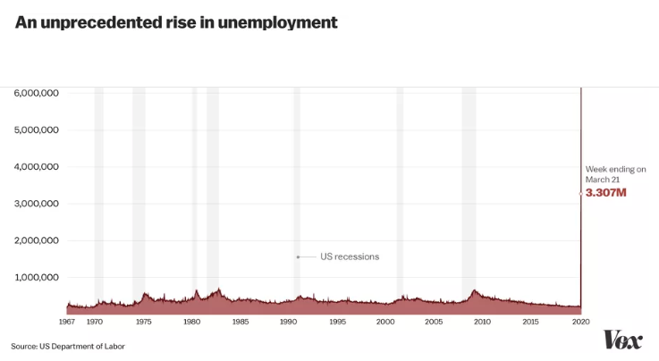
Appendix F - US Weekly Unemployment Claims

Slide 18
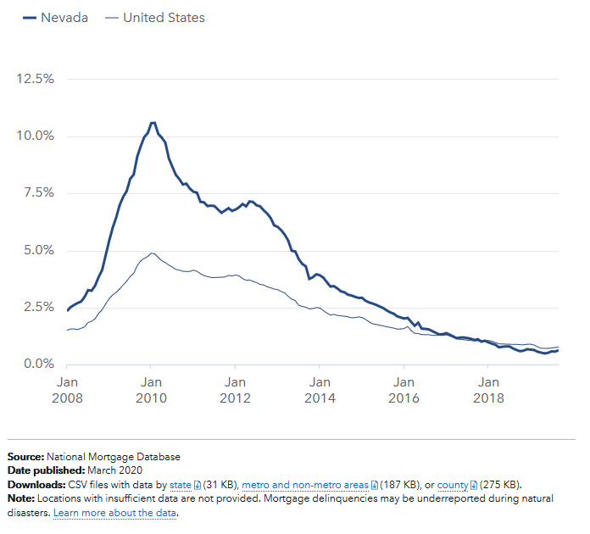
Appendix G -

Slide 19

Appendix H: Biography of assigned Professional Services Coordinator and Role
Denis is a proven consultant and senior executive leader with deep experience guiding enterprise software deployment projects and services companies throughout various lifecycle phases including start-up, rapid growth and maturity. Prior to joining the IndiSoft Team, Denis was CEO of two leading default-related services businesses that utilized the RxOffice technology suite.
Denis will provide day-to-day executive leadership of the program to ensure delivery within scope, on-time and within budget.
Denis be the primary liaison between IndiSoft and Home Means Nevada (HMN) and, given his 20+ years of mortgage servicing experience, he will help HMN secure adoption of the solution across the industry and in governmental circles.
Denis Brosnan
Professional Services Lead

Slide 20
Appendix I – Professional Services Phase I Detail
Phase I: Project Planning:
Review the overall Solution to ensure it addresses all the strategic goals of the Client and the operational considerations that it must address to achieve the desired outcomes
Prepare an Implementation Strategy and develop a high-level Project Plan and phasing
Compile a Team, set deadlines & governance expectations

Slide 21
Appendix J – Professional Services Phases 2-3 Detail
Phase 2: Systems Configuration, Testing & Adoption
Oversee software configuration efforts and User Acceptance Testing (UAT) projects
Inventory existing processes that will be effected and assist the client determine how to address any People, Process and Technology (PPT) gaps that need to be remedied before Go Live
Inventory training needs and coordinate the planning of any training to be provided by IndiSoft
Phase 3: Launch & Solution Governance
Document the Client’s fulfillment organizational models & review internal metrics and assist in preparing dashboards, etc., for each key functional area
Assist in developing counselor/vendor scorecards, audit procedures and SLA’s (as applicable)
Develop & assist in executing launch plan including communications with key stakeholders such as mortgage servicers, investors, other government agencies, etc.

Slide 22
Appendix K – Estimated Cost Table

Slide 23
CONFIDENTIALITY REMINDER
This presentation is subject to the Non-Disclosure agreement signed by your organization and IndiSoft; information contained herein is strictly confidential.
You are not allowed to disclose any information outside your organization. Except for the publicly announced clients (as listed on our website), IndiSoft considers matters relating to all other clients and vendor relationships as confidential information.
Also, use of information is strictly limited to the stated purposes in the signed Non-Disclosure Agreement.

